Slide 1


Khai thác dữ liệu văn bản và ứng dụng
Group 04
Instructors: Mr. Le Thanh Tung
Ms. Tran Thi Thao Nhi
Danh sách thành viên:
20127674: LÊ ĐỨC ĐẠT
19127359: TRƯƠNG DIỆU ĐẠT
20127552: VƯƠNG HUỲNH TẤN LỘC
TEXT CLASSIFICATION WITH BERT

Slide 2
Phân công công việc:
Danh sách thành viên:
20127674: LÊ ĐỨC ĐẠT (80%)
Code, Làm slide chung(Doc to deck trên Canva)
19127359: TRƯƠNG DIỆU ĐẠT(10%)
Làm slide lí thuyết
20127552: VƯƠNG HUỲNH TẤN LỘC(10%)
Làm slide lí thuyết
TEXT CLASSIFICATION WITH BERT

Slide 3

1. WHAT IS BERT
BERT (Bidirectional Encoder Representations from Transformers) is a language model developed by Google in 2018. BERT has achieved breakthrough results in many natural language processing (NLP) tasks such as text classification. , predict the next sentence, answer questions, and understand semantics.

Slide 4

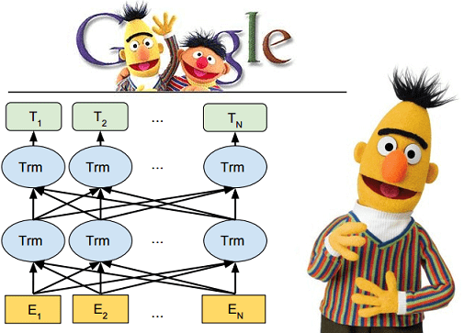

BERT history:
BERT was originally published by Google researchers Jacob Devlin, Ming-Wei Chang, Kenton Lee, and Kristina Toutanova in 2018.
On October 25, 2019, Google announced that they had started applying BERT models for English language search queries within the US. On December 9, 2019, it was reported that BERT had been adopted by Google Search for over 70 languages. In October 2020, almost every single English-based query was processed by a BERT model.

Slide 5
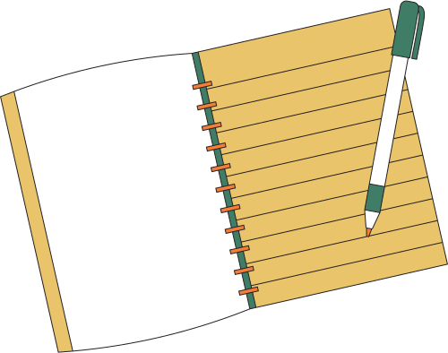

Some of the key features of the BERT model

Slide 6
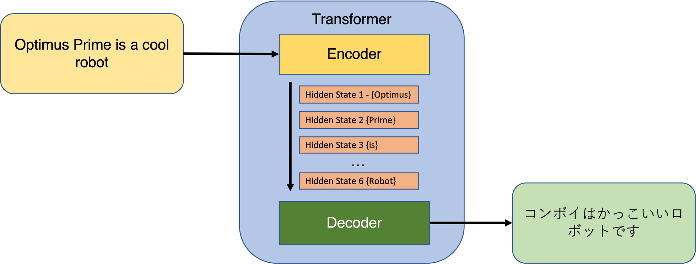
INCLUDE
Transformer Architecture: BERT uses the Transformer architecture, a self-attention-based structure that allows the model to focus on relationships between words in a sentence.

Slide 7
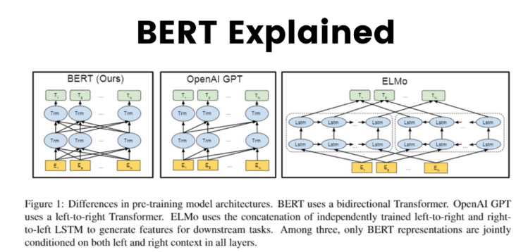
Bidirectional training: BERT is trained to understand the context in both directions (left-to-right and right-to-left), allowing better semantic capture than one-way training models.

Slide 8
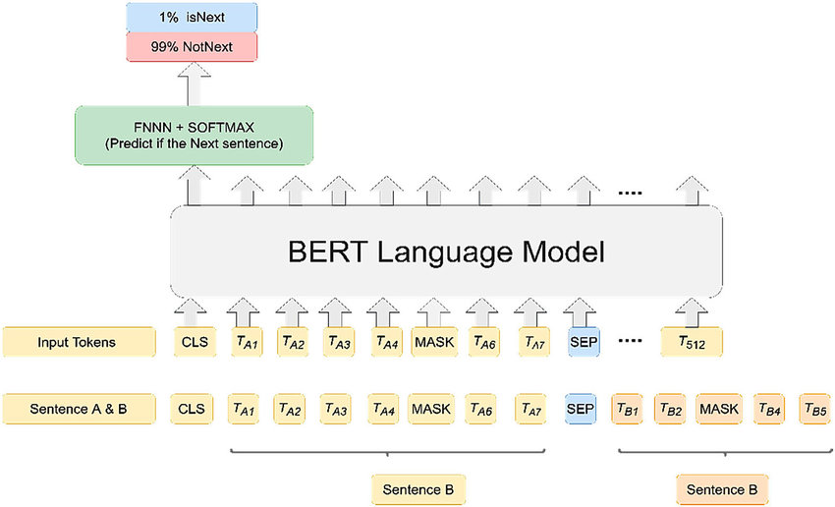
Unsupervised Training: BERT is trained on unsupervised data using two techniques: Masked Language Model and Next Sentence Prediction .This allows BERT to learn from large amounts of textual data without the need for labels.

Slide 9
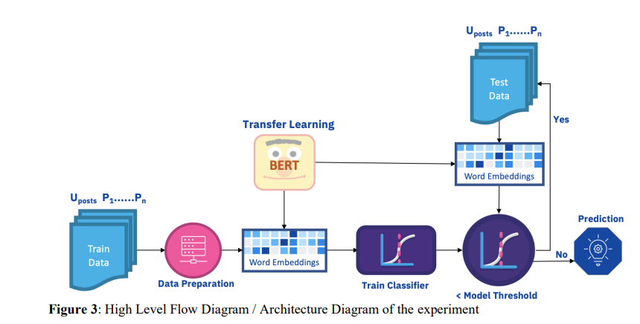
Transfer learning: BERT can be fine-tuned to solve specific tasks by transferring knowledge learned from training on unsupervised data. This improves performance and reduces training time for many NLP tasks.

Slide 10
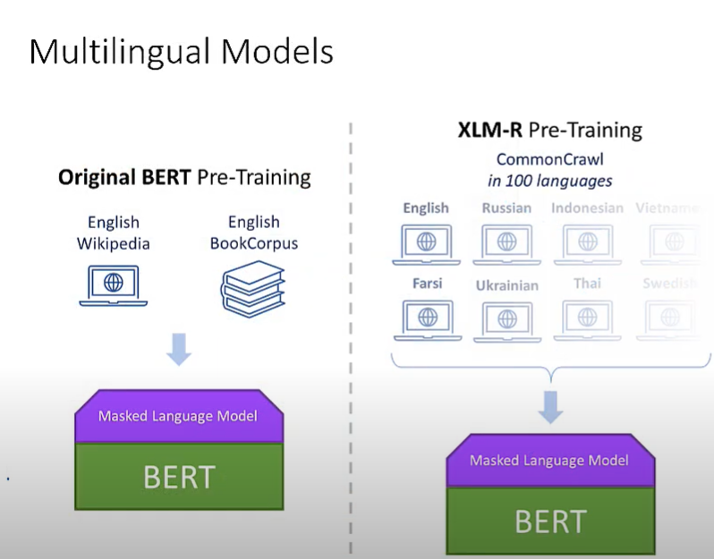

Multilingual model: BERT is available in multiple versions that have been trained on multilingual data, allowing support for many different languages.

Slide 11
2. DATASET, INPUT AND OUTPUT

Slide 12
After you have downloaded the BERT model and created the tokenizer, you need to prepare the dataset, input and output data as follows:

Slide 13
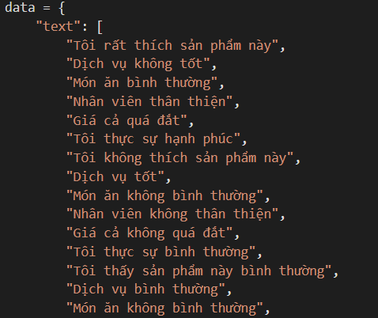
Dataset: Search or create a dataset consisting of Vietnamese documents/TEXT labeled as positive (1), neutral (0) and negative (2). This dataset will be used to train and test your models.

Slide 14
Input data: Input data includes Vietnamese documents/TEXT from dataset. You need to split the dataset into two subsets: the training set and the test set. The training set will be used to train the model, while the test set helps to evaluate the performance of the model.

Slide 15
Output data: Output data are labels corresponding to the texts in the training and test sets. These labels are used to monitor the model training and evaluate the model's performance on the test set.

Slide 16
Steps to take

Slide 17
After preparing the dataset, input and output data, you can proceed to train and evaluate the BERT, TF-IDF, Word2Vec and Bag-of-words models

Slide 18
Data preprocessing: Use BERT's tokenizer to encode the sentences in the training and test sets. For TF-IDF, Word2Vec and Bag-of-words, use "underthesea" library to separate Vietnamese words.

Slide 19
Model training: Train BERT, TF-IDF, Word2Vec and Bag-of-words models on the training set.

Slide 20
Model evaluation: Use the trained models to predict the labels of the texts in the test set. Calculate the accuracy of each model by comparing the predicted results with the actual labels.

Slide 21
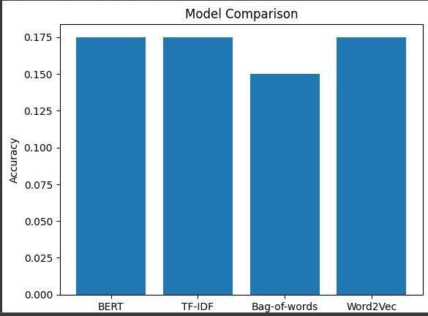
Graphing: Plot a column graph to compare the accuracy of BERT, TF-IDF, Word2Vec and Bag-of-words models.

Slide 22
EXAMPLES TO COMPARE ENGLISH AND VIETNAMESE TEXT CLASSIFICATION WITH BERT

Slide 23
ENGLISH

Slide 24
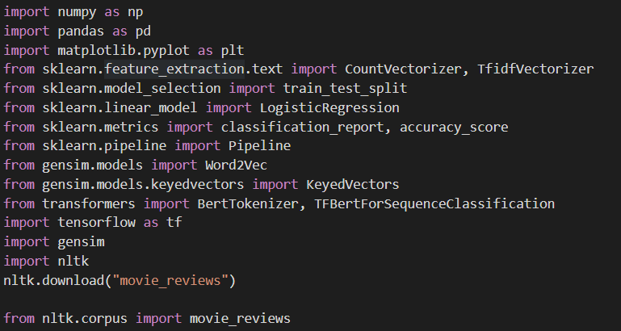
LIBRARIES

Slide 25
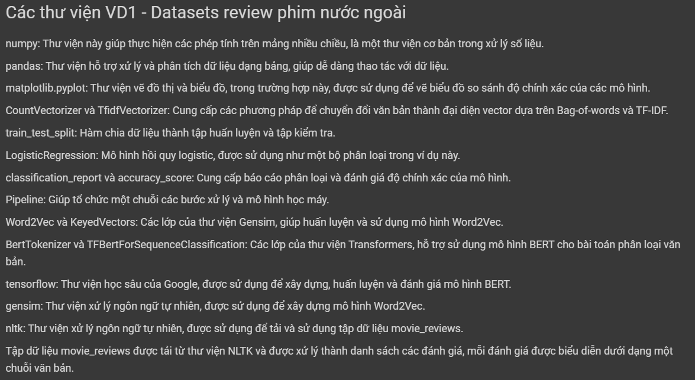
LIBRARIES

Slide 26
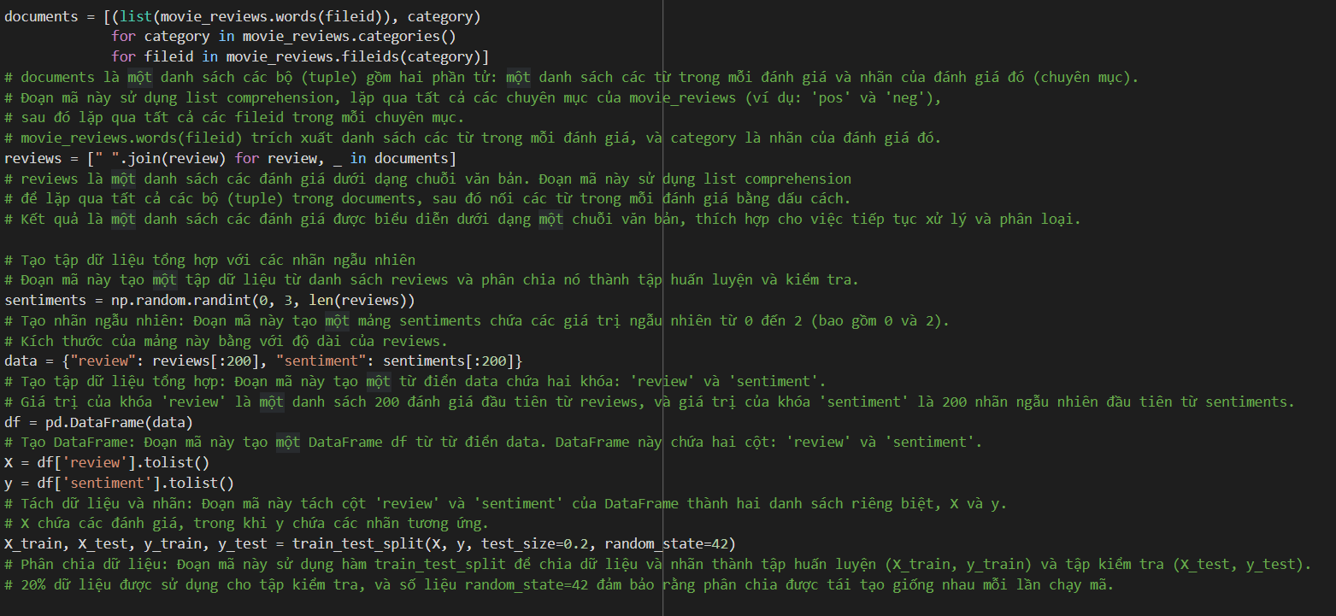
SETUP DATASETS

Slide 27
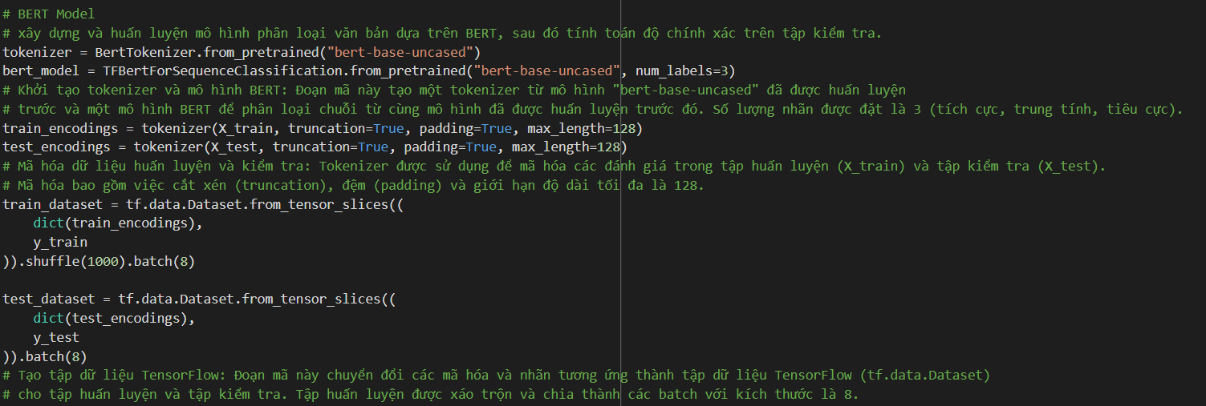
BERT MODEL

Slide 28
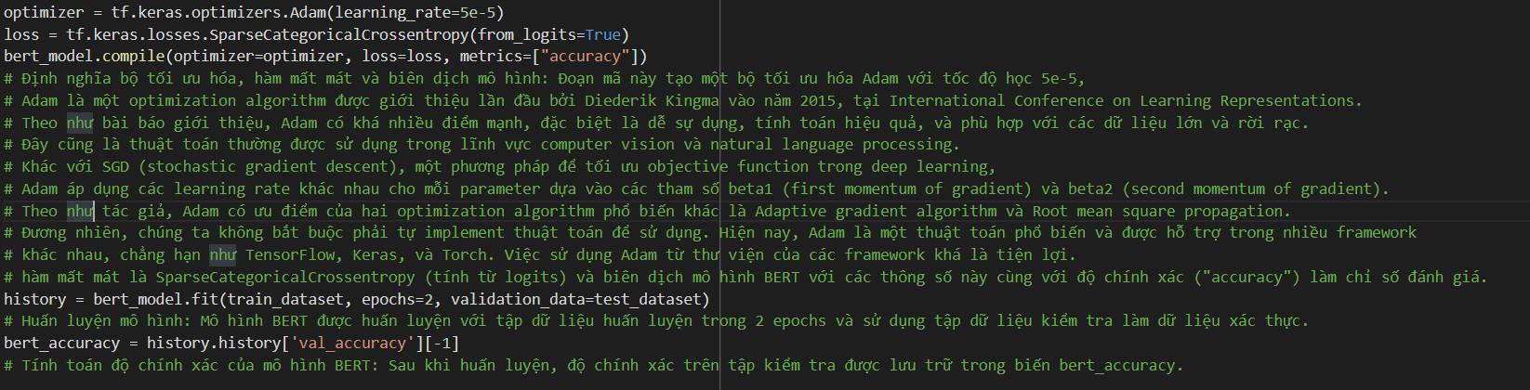
BERT MODEL

Slide 29
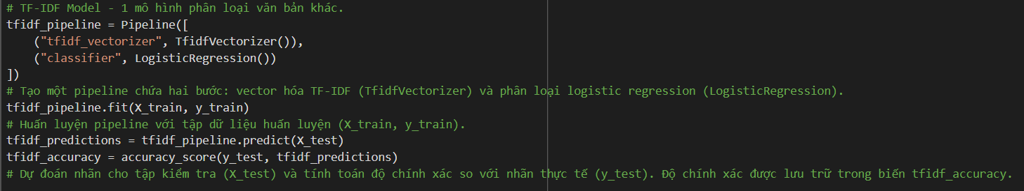
TF-IDF MODEL

Slide 30
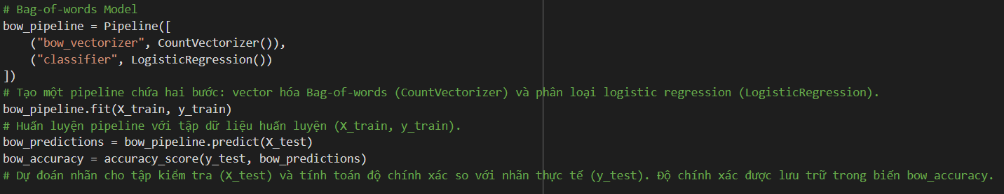
BAG-OF-WORDS MODEL

Slide 31
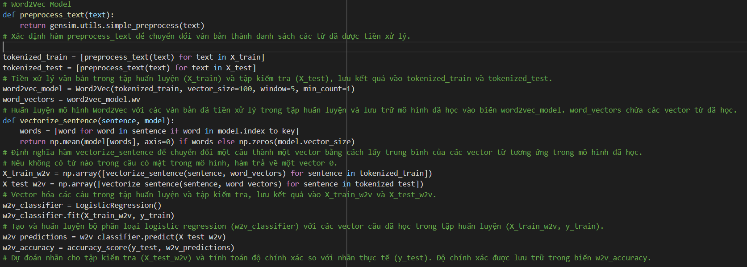
WORD2VEC MODEL

Slide 32
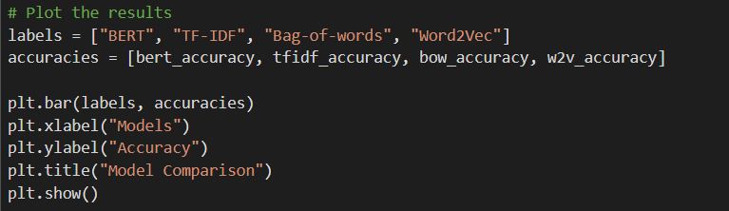
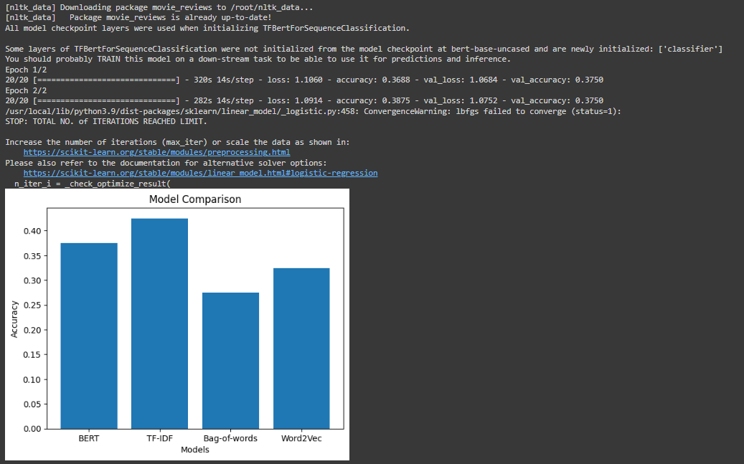
RESULT AS BAR-CHART

Slide 33
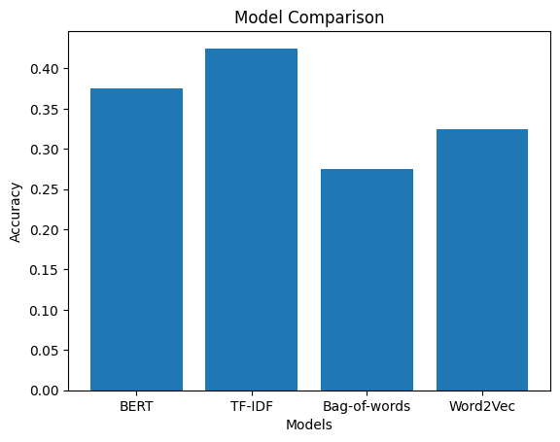
RESULT AS BAR-CHART

Slide 34
HOW ABOUT VIETNAMESE TEXT?

Slide 35

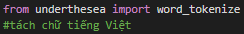
LIBRARIES
Similar to English, but we add "Underthesea" module/Library in order to tokenize Vietnamese Words in sentences.

Slide 36
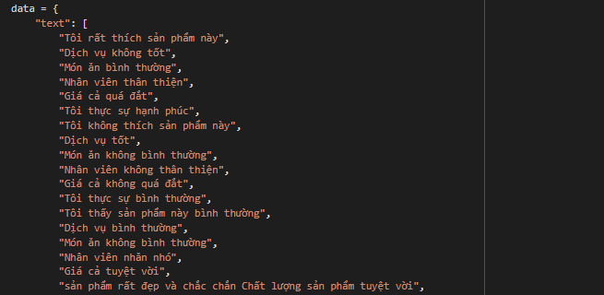
PREPARING DATASETS
We use 47 comments in Vietnamese - 47 labels
1 - positive
0 - neutral
2 - negative

Slide 37
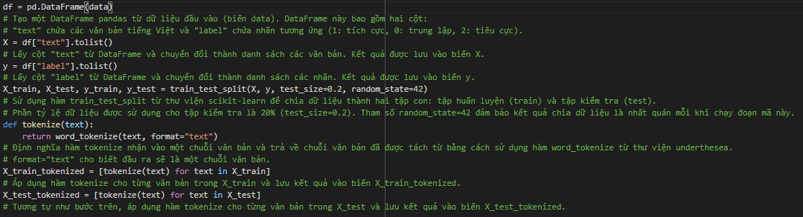
SETUP DATASETS

Slide 38
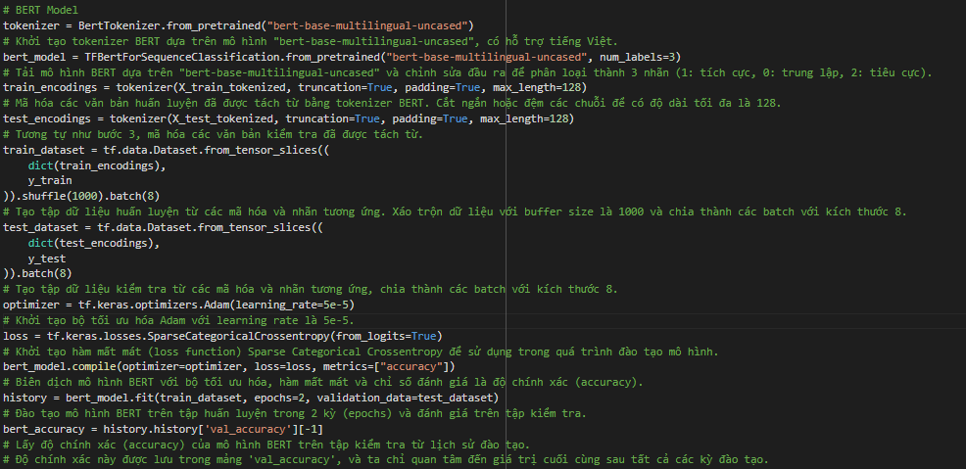
BERT MODEL

Slide 39
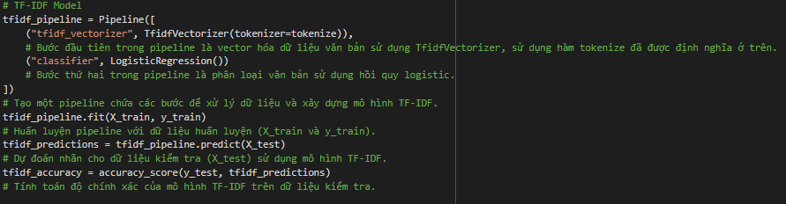
TF-IDF MODEL

Slide 40
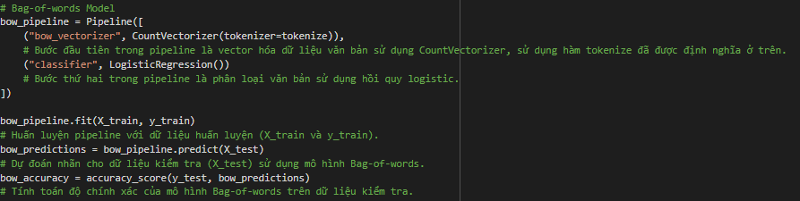
TF-IDF & BAG-OF-WORDS MODELS

Slide 41
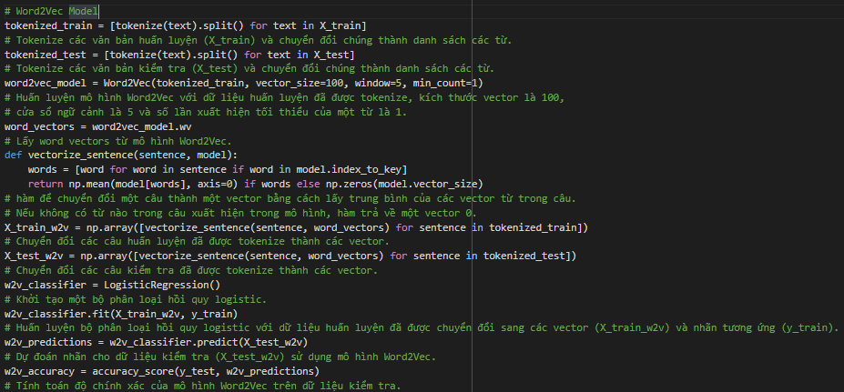
WORD2VEC MODEL

Slide 42
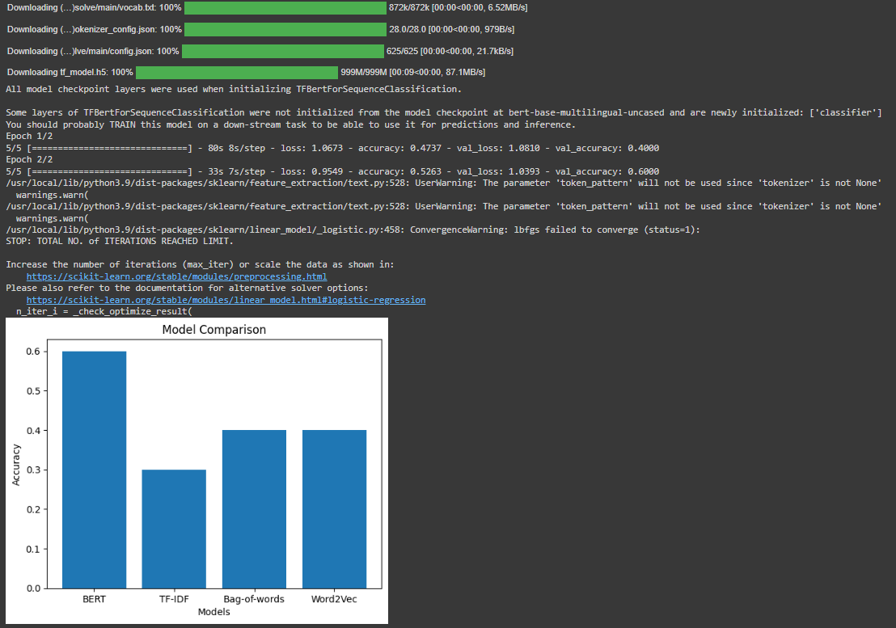
TRAINING RESULT

Slide 43
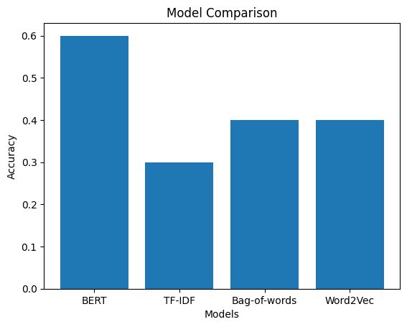
BAR-CHART MODELS COMPARISON

Slide 44
THANKS FOR LISTENING

